Slide 1
Topic: Financial Maths EQ: How Do I Calculate Percentage Increase or decrease?
Rule up 3 column notes!
Year 8 Mathematics
Mrs Parlevliet

Slide 2
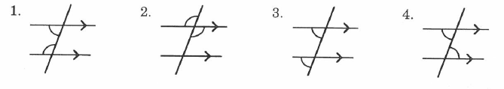
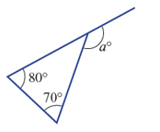
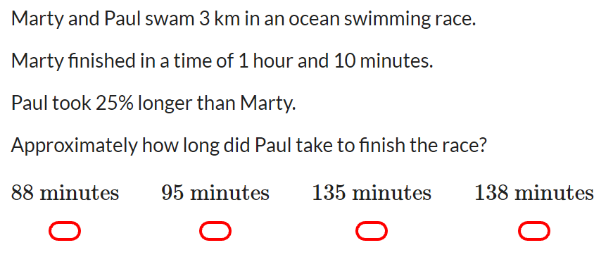

Five Questions (LHS)
Topic: Financial Maths
Date: XX/XX/2019
EQ – How do I calculate a percentage increase or decrease?
What type of angles are shown in the following?
What is the size of the exterior angle of this triangle?
Solve for $x$ if $2x+8=26$.
Find 40% of $120.

Slide 3
24
7
30
Topic: Financial Maths
Date: XX/XX/2019
EQ – How do I calculate percentage increase and decrease?
Question
Examples
Steps
Increase $2,700 by 22%
1. Turn the % into a fraction
2. Multiply by the number
3. Add the new amount to the original number
What is a % Increase?

Slide 4
24
7
30
Topic: Financial Maths
Date: XX/XX/2019
EQ – How do I calculate percentage increase and decrease?
Question
Examples
Steps
Decrease 163kg by 45%
1. Turn the % into a fraction
2. Multiply by the number
3. Subtract the new amount to the original number
What is a % Decrease?

Slide 5
24
7
30
Topic: Financial Maths
Date: XX/XX/2019
EQ – How do I calculate percentage increase and decrease?
Question
Examples
Steps
Tori earns $950 per week as an electrician. She receives a pay increase of $32 per week. Find out by how much Tori’s pay increased by as a percentage.
1. Write the amount of the increase as a fraction over the original amount.
2. Multiply by 100%
3. Write the answer as a percent
How to find the %?

Slide 6


Slide 7
LHS – Percentage Increase Practice

Slide 8
LHS – Percentage decrease Practice

Slide 9
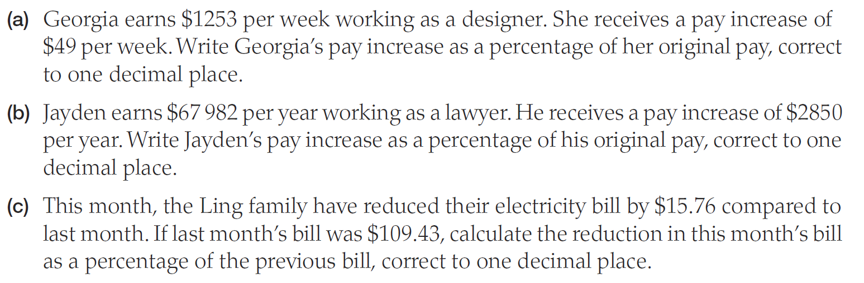
LHS – WheRe is this Maths Used?

Slide 10
LHS – Where is this maths used?

Slide 11
LHS – Where is this maths used?

Slide 12
Percentage share trading game Adapted from Dizzle Education www.dizzleeducation.com
You will need a calculator.
Form a group of 3.

Slide 13
Instructions:
At the start of each round there will be a ‘newsflash’. Your team will need to decide what commodities to invest your $2,000 in
At the end of the round, you will sell all your commodities at the new prices and record how much profit you made that round
At the end of the six rounds, you will work out your overall profit
The winning team is the one that makes the most profit
There will be a fine of $500 for each mathematical mistake a team makes, and any teams that fail to work together will also be fined.
Percentage Trading Game

Slide 14
Current World Market Prices:
Commodity | Price | Amount Invested | Percentage Change | New Price
Oil | $80
Diamonds | $150
Wheat | $60
Gold | $120
Cocoa | $50
Silver | $100
Percentage Trading Game
Percentage Trading Game

Slide 15
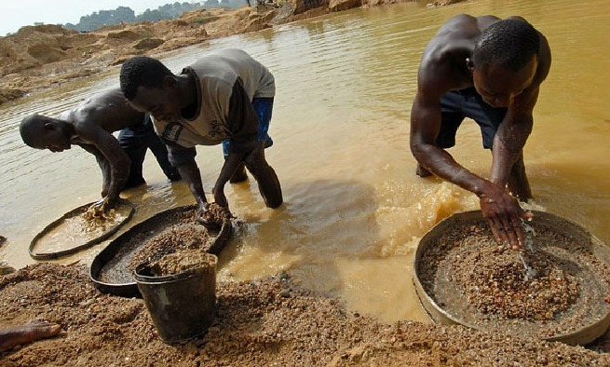
Round 1:
Renewed violence in Sierra Leone scares off international investors
Percentage Trading Game
Percentage Trading Game

Slide 16
World Market Price Changes after Round 1:
Commodity | Price | Percentage Change
Oil | $80 | +10%
Diamonds | $150 | +40%
Wheat | $60 | 0
Gold | $120 | +20%
Cocoa | $50 | 0
Silver | $100 | 0
Percentage Trading Game
Percentage Trading Game

Slide 17
Current World Market Prices:
Commodity | Price | Amount Invested | Percentage Change | New Price
Oil | $80 |  | +10%
Diamonds | $150 |  | +40%
Wheat | $60 |  | 0
Gold | $120 |  | +20%
Cocoa | $50 |  | 0
Silver | $100 |  | 0
Percentage Trading Game
Percentage Trading Game

Slide 18
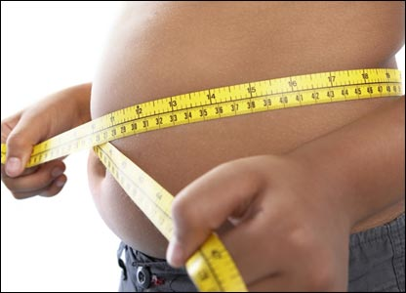
Round 2:
New worldwide obesity campaign launched
Percentage Trading Game
Percentage Trading Game

Slide 19
World Market Price Changes after Round 2:
Commodity | Price | Percentage Change
Oil | $80 | + 5%
Diamonds | $150 | 0
Wheat | $60 | - 10%
Gold | $120 | + 1%
Cocoa | $50 | - 15%
Silver | $100 | -40%
Percentage Trading Game
Percentage Trading Game

Slide 20
Current World Market Prices:
Commodity | Price | Amount Invested | Percentage Change | New Price
Oil | $80 |  | + 5%
Diamonds | $150 |  | 0
Wheat | $60 |  | - 10%
Gold | $120 |  | + 1%
Cocoa | $50 |  | - 15%
Silver | $100 |  | -40%
Percentage Trading Game
Percentage Trading Game

Slide 21

Round 3:
Storms devastate harvest across Russia and Eastern Europe
Percentage Trading Game
Percentage Trading Game

Slide 22
World Market Price Changes after Round 3:
Commodity | Price | Percentage Change
Oil | $80 | + 15%
Diamonds | $150 | 0
Wheat | $60 | + 60%
Gold | $120 | + 10%
Cocoa | $50 | 0
Silver | $100 | + 5%
Percentage Trading Game

Slide 23
Current World Market Prices:
Commodity | Price | Amount Invested | Percentage Change | New Price
Oil | $80 |  | + 15%
Diamonds | $150 |  | 0
Wheat | $60 |  | + 60%
Gold | $120 |  | + 10%
Cocoa | $50 |  | 0
Silver | $100 |  | + 5%
Percentage Trading Game
Percentage Trading Game

Slide 24
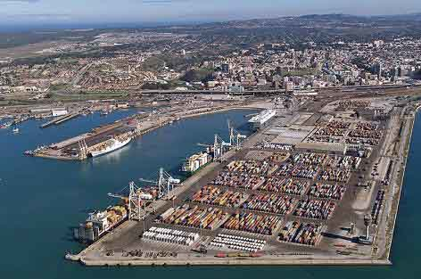
Round 4:
Long-running strikes in South Africa reduce the country’s exports
Percentage Trading Game

Slide 25
World Market Price Changes after Round 4:
Commodity | Price | Percentage Change
Oil | $80 | +15%
Diamonds | $150 | +45%
Wheat | $60 | 0
Gold | $120 | +60%
Cocoa | $50 | 0
Silver | $100 | +55%
Percentage Trading Game

Slide 26
Current World Market Prices:
Commodity | Price | Amount Invested | Percentage Change | New Price
Oil | $80 |  | +15%
Diamonds | $150 |  | +45%
Wheat | $60 |  | 0
Gold | $120 |  | +60%
Cocoa | $50 |  | 0
Silver | $100 |  | +55%
Percentage Trading Game
Percentage Trading Game

Slide 27
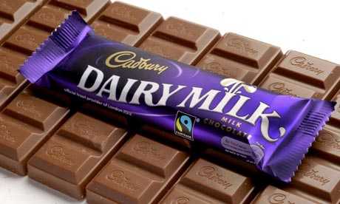
Round 5:
Fairtrade fortnight boosts Cadbury's revenues
Percentage Trading Game

Slide 28
World Market Price Changes after Round 5:
Commodity | Price | Percentage Change
Oil | $80 | +10%
Diamonds | $150 | 0
Wheat | $60 | 0
Gold | $120 | 0
Cocoa | $50 | +36%
Silver | $100 | 0
Percentage Trading Game

Slide 29
Current World Market Prices:
Commodity | Price | Amount Invested | Percentage Change | New Price
Oil | $80 |  | +10%
Diamonds | $150 |  | 0
Wheat | $60 |  | 0
Gold | $120 |  | 0
Cocoa | $50 |  | +36%
Silver | $100 |  | 0
Percentage Trading Game
Percentage Trading Game

Slide 30
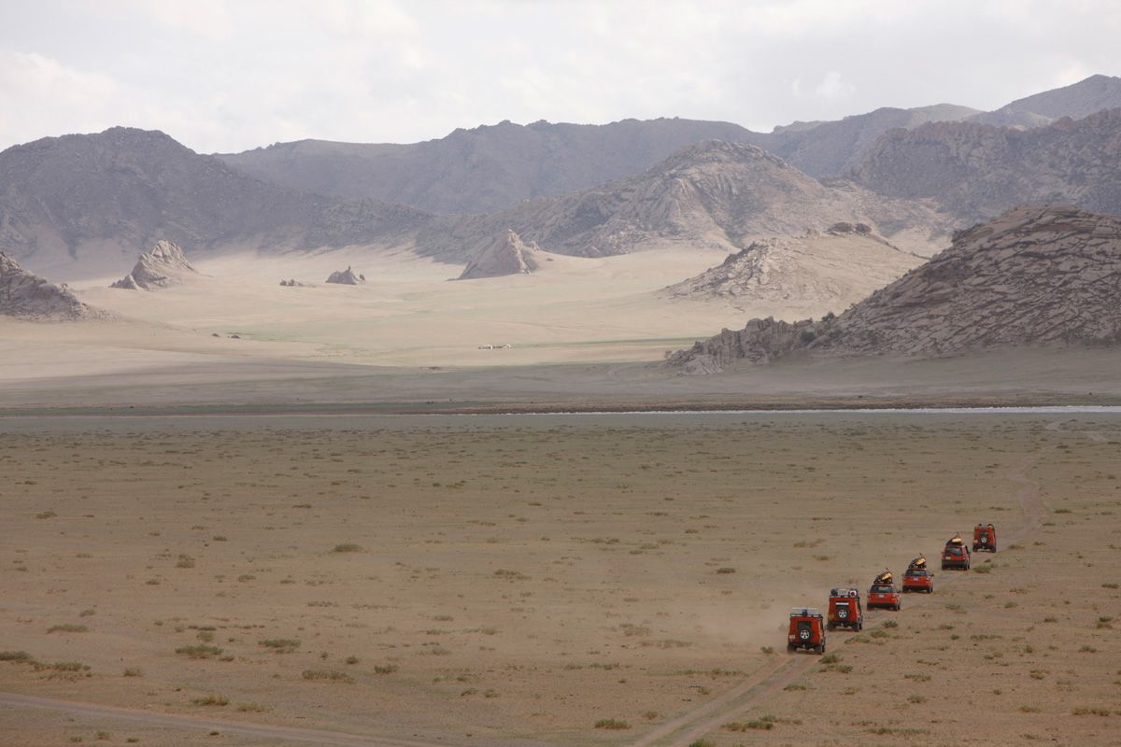
Round 6:
Mongolia’s economy may grow by 25% if foreign investment takes off
Percentage Trading Game

Slide 31
World Market Price Changes after Round 6:
Commodity | Price | Percentage Change
Oil | $80 | +15%
Diamonds | $150 | 0
Wheat | $60 | 0
Gold | $120 | +40%
Cocoa | $50 | 0
Silver | $100 | +57%
Percentage Trading Game

Slide 32
Current World Market Prices:
Commodity | Price | Amount Invested | Percentage Change | New Price
Oil | $80 |  | +15%
Diamonds | $150 |  | 0
Wheat | $60 |  | 0
Gold | $120 |  | +40%
Cocoa | $50 |  | 0
Silver | $100 |  | +57%
Percentage Trading Game
Percentage Trading Game

Slide 33
The End:
Calculate your ‘final profit’ by adding up the total profit you made in each round
Questions to consider:
When did you make the most profit?
Why was this?
Why is it important to be able to quickly complete percentage calculations?
Percentage Trading Game

